Slide 1

Models in business innovation
Prof. Dr. Josef Herget
Excellence Institute – Research & Solutions
Vienna - Austria

Slide 2

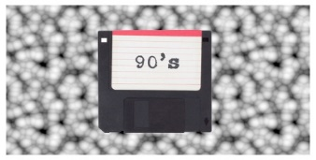



Roadmap into Digital Economy and Society
1950
1980
2000
2010
2020
1950 – 1980
1980 – 2000
2000 – 2010
2010 – 2020
2020 –
IT automated processes
IT enables new processes
IT changes Interactions
IT changes markets
IT is market and living sphere
Big - IT, Mass Data
Goal: Efficiency
PC everywhere Productivity
Goal: Effectivity
Internet
Goal: Change of Business Models
Mobile, Cloud, Social, Big Data, IOT
Goal: Disruption, new Business Models
Digitalisiation, AI, Augmented Reality
Goal: Creation of New Realities

Slide 3
4 Generic Types of Innovation
Product Innovation
Process Innovation
Business Model Innovation
Social Innovation

Slide 4
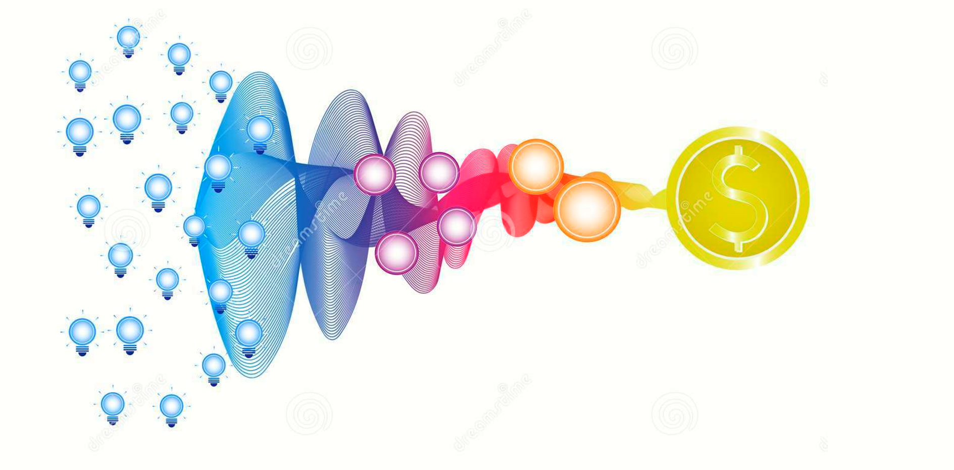
Central Question: How to achieve Innovation?

Slide 5
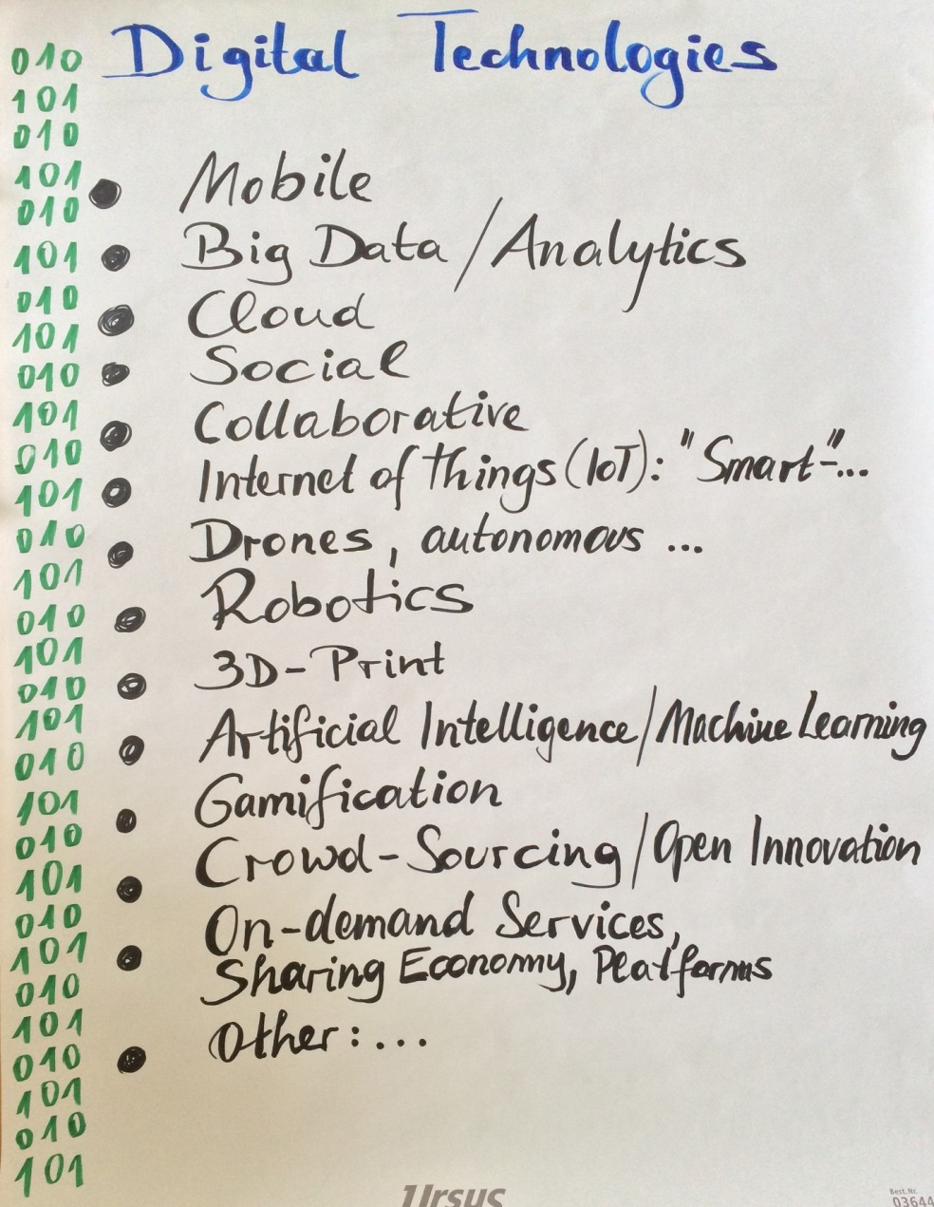
Successful Innovation Model in
4 Phases
Phase 1: Identify relevant
Technologies/Methods

Slide 6
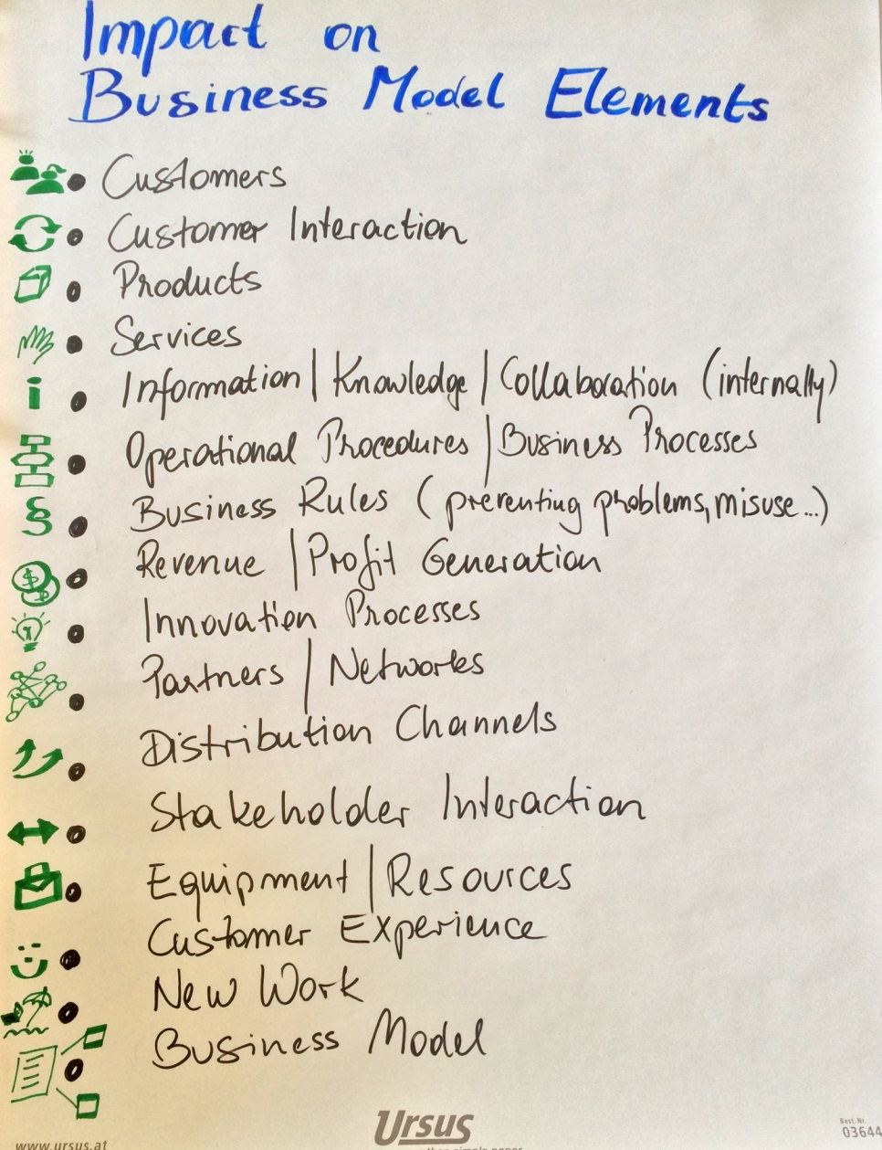
Successful Innovation Model in
4 Phases
Phase 2: Identify relevant
Business Model Elements

Slide 7
Successful Innovation Model in
4 Phases
Phase 3: Ask following
questions
4 Questions as starting point for discussion
What contribution can technology make to solving a current problem?
How can existing solutions be improved by using new technologies/methods?
What potential does the technology have to become excellent in a field, i.e. market leader?
Which new market logics can result from a link?

Slide 8
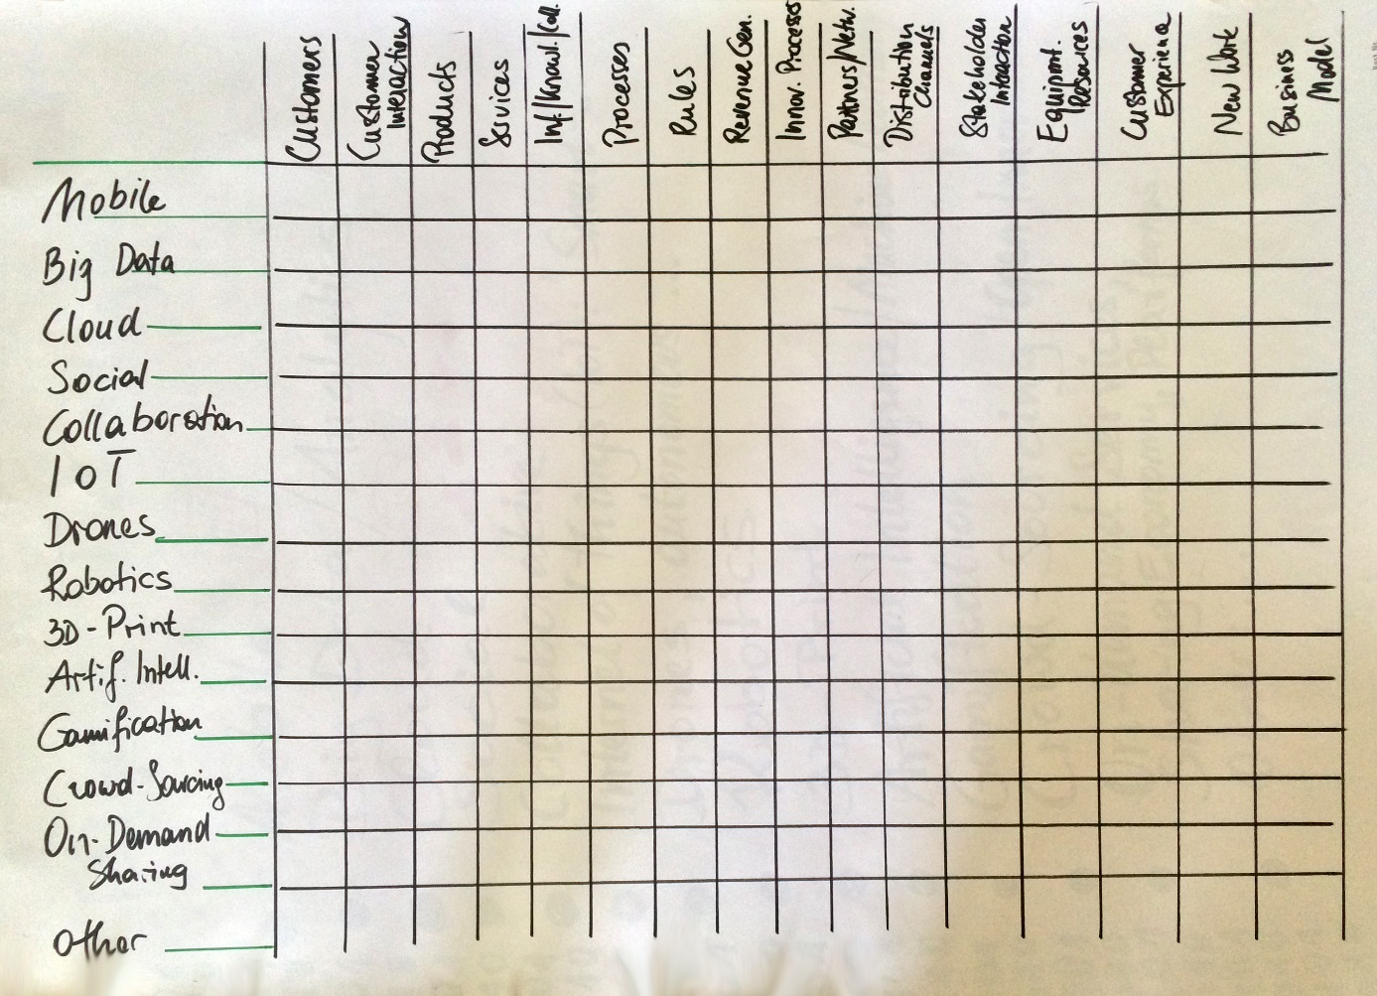
Successful Innovation Model in
4 Phases
Phase 4: Synthesize

Slide 9


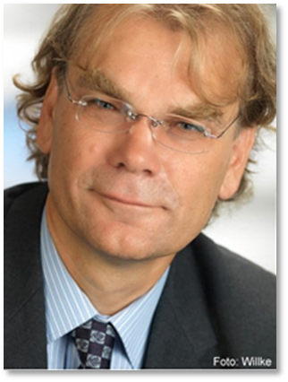
Prof. Dr. Josef Herget
Director
Excellence Institute – Research & Solutions
Leonard-Bernstein-Str 8/2/28.5
1220 Wien
josef.herget@excellence-institute.at
www.excellence-institute.at

