Slide 1
Data Science and Graph Models
Applied to Fraud Detection
Tuesday 7st of Septembre, 2016

Slide 2

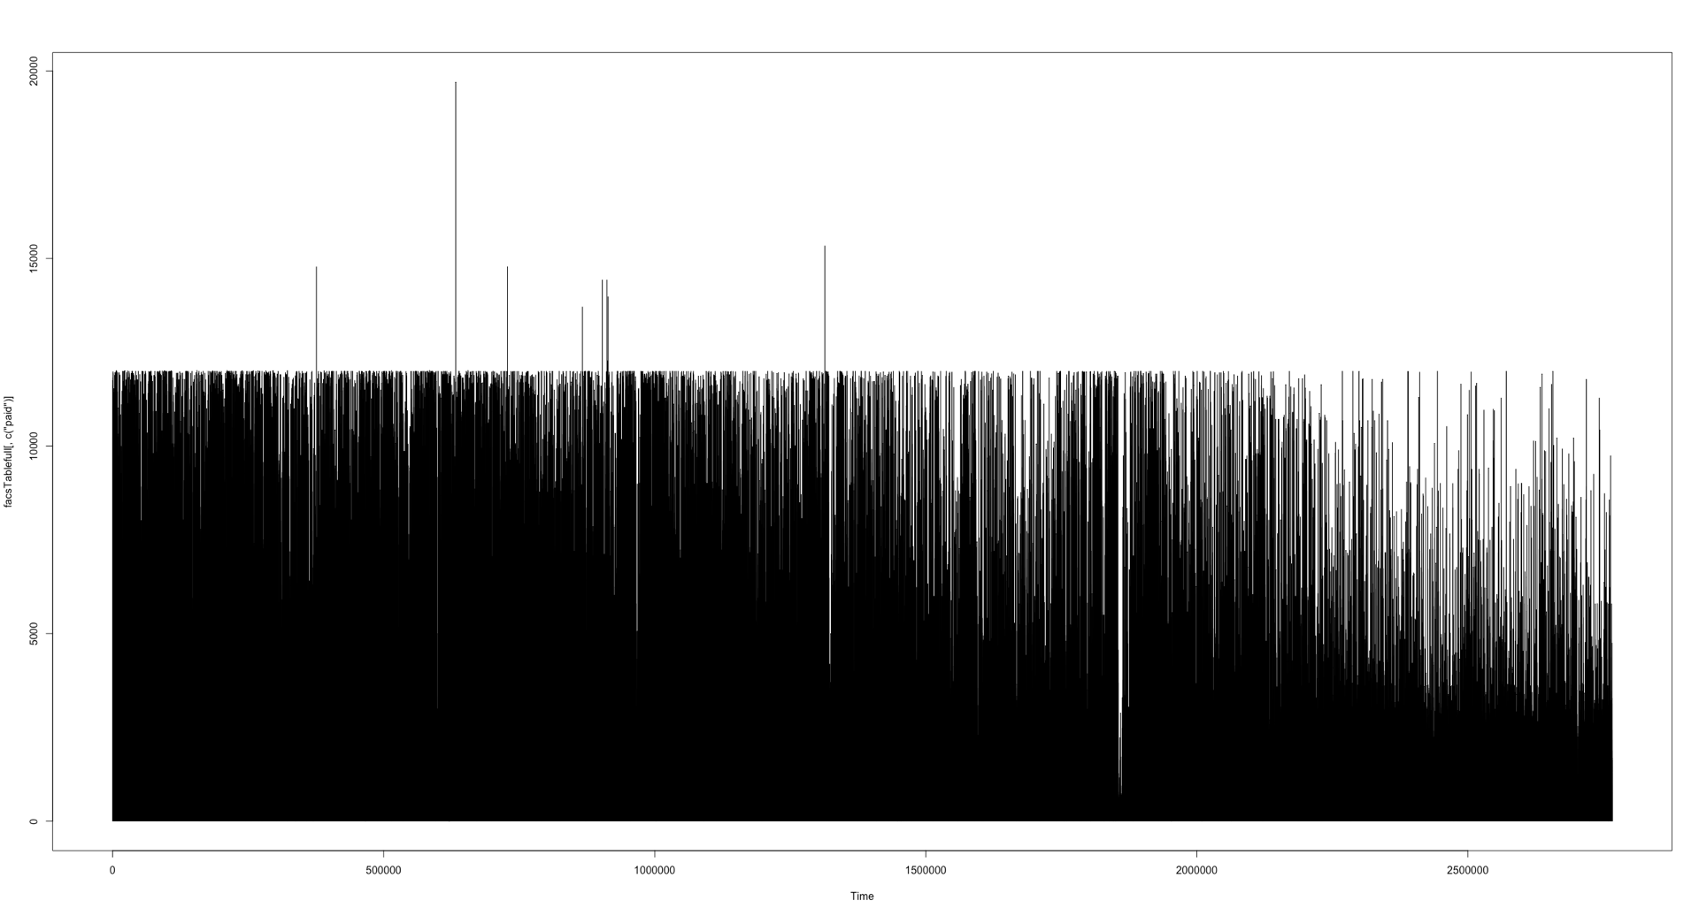

Data Science
… and Data
?
?
?

Slide 3
Data Science
… and Data

Slide 4
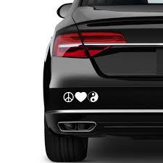

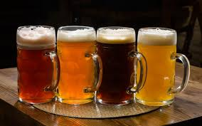
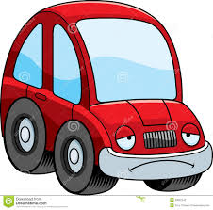
Data Science
Timing is everything

Slide 5

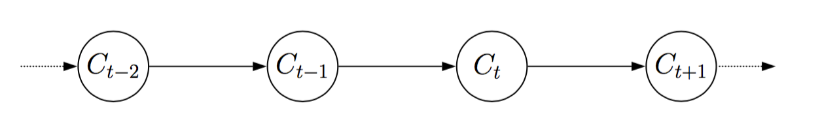

Data Science
Hypotesis

Slide 6
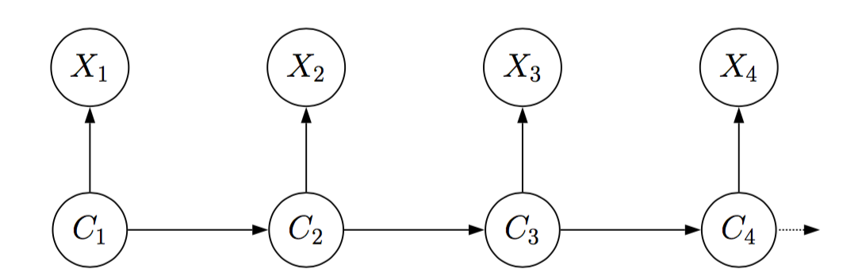
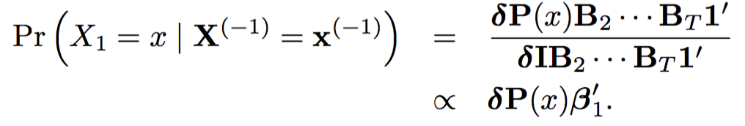
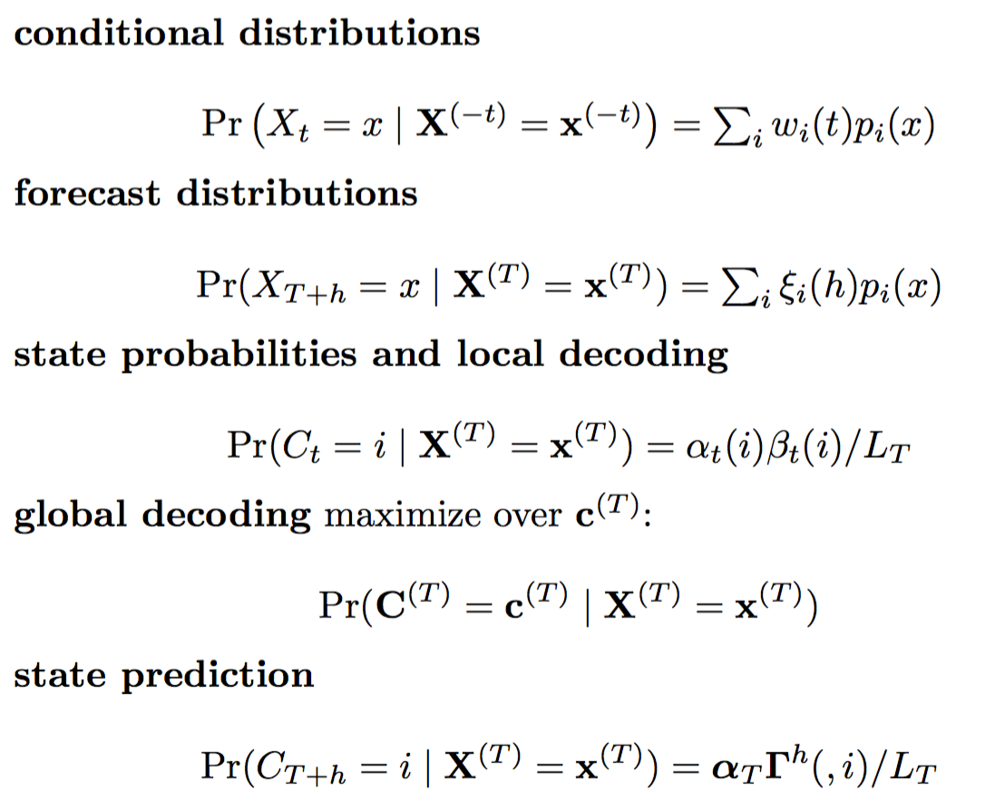

Data Science
Anécdota

Slide 7





Data Science
Nada fantascienza

Slide 8
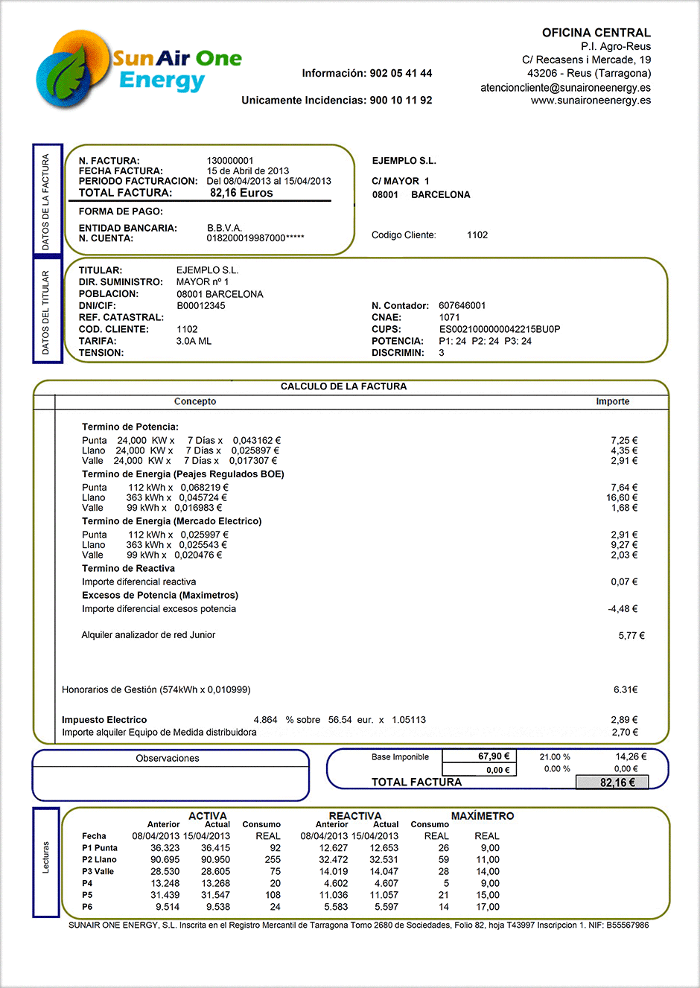
Data Science
Dimensionality reduction: 2D

Slide 9
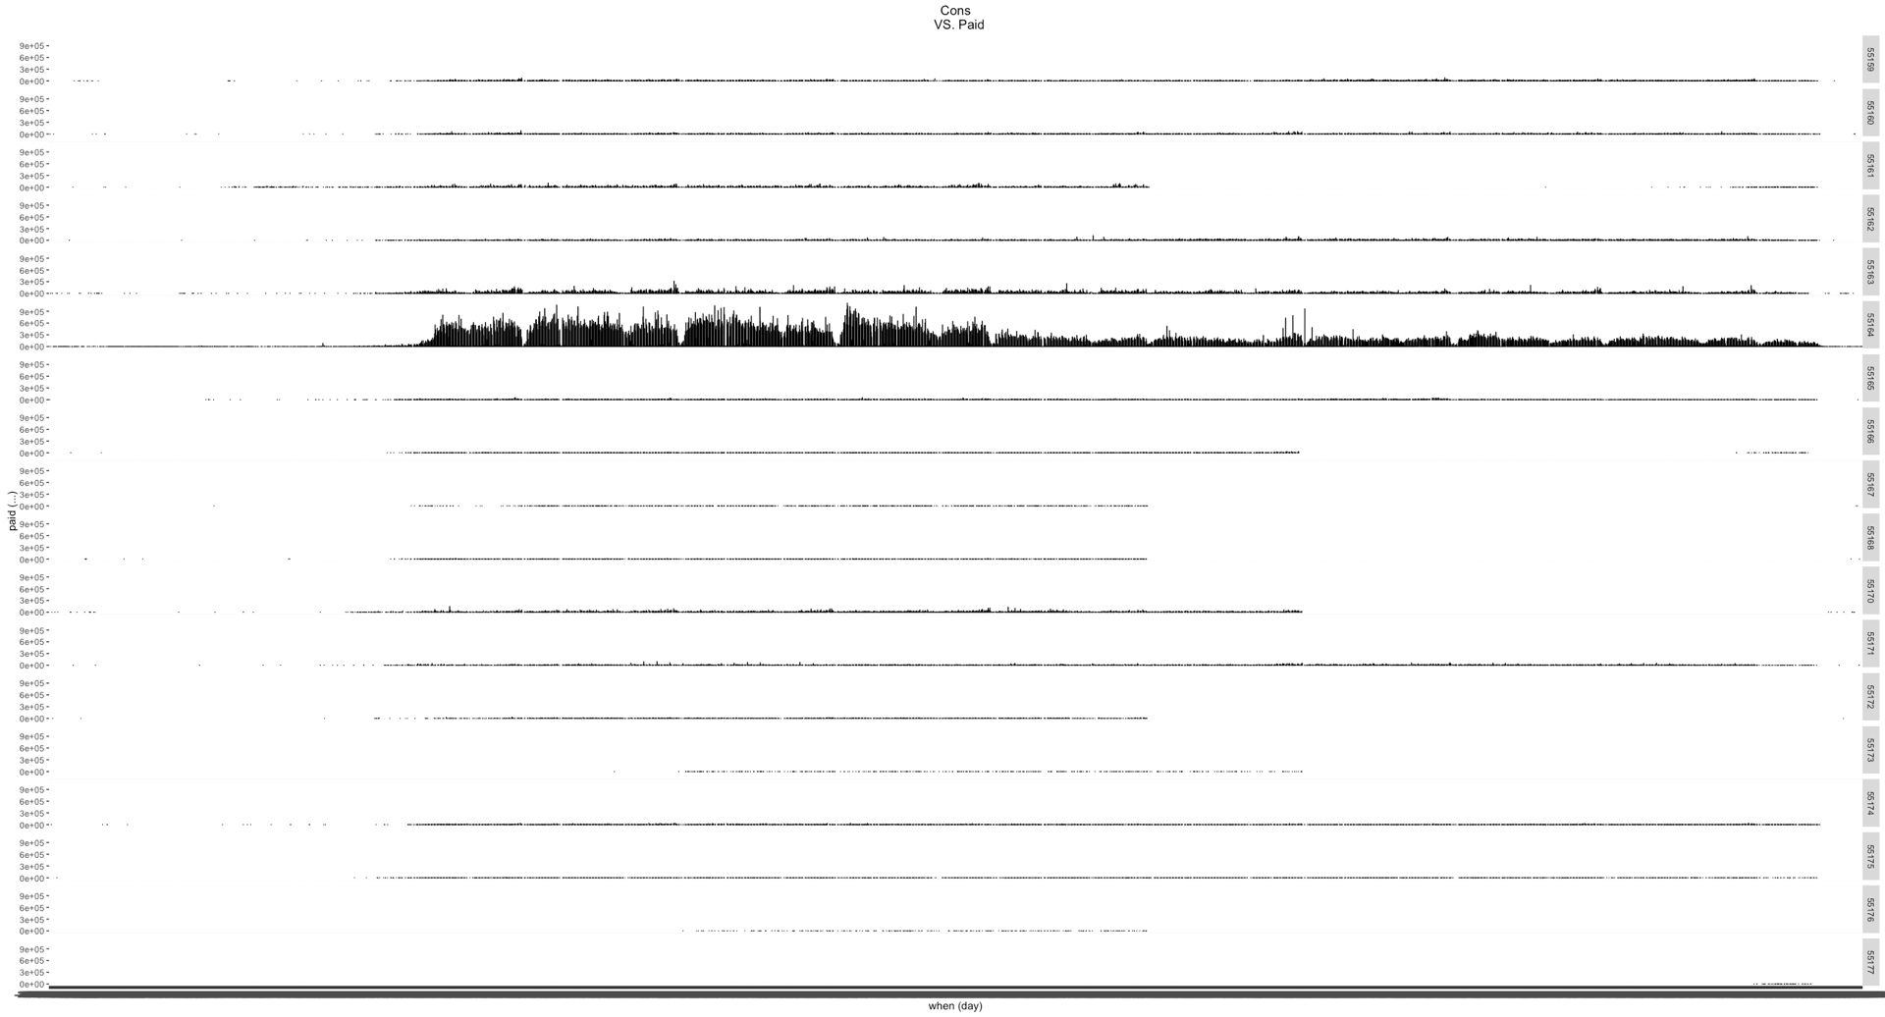
Data Science
Dimensionality reduction: 3D

Slide 10
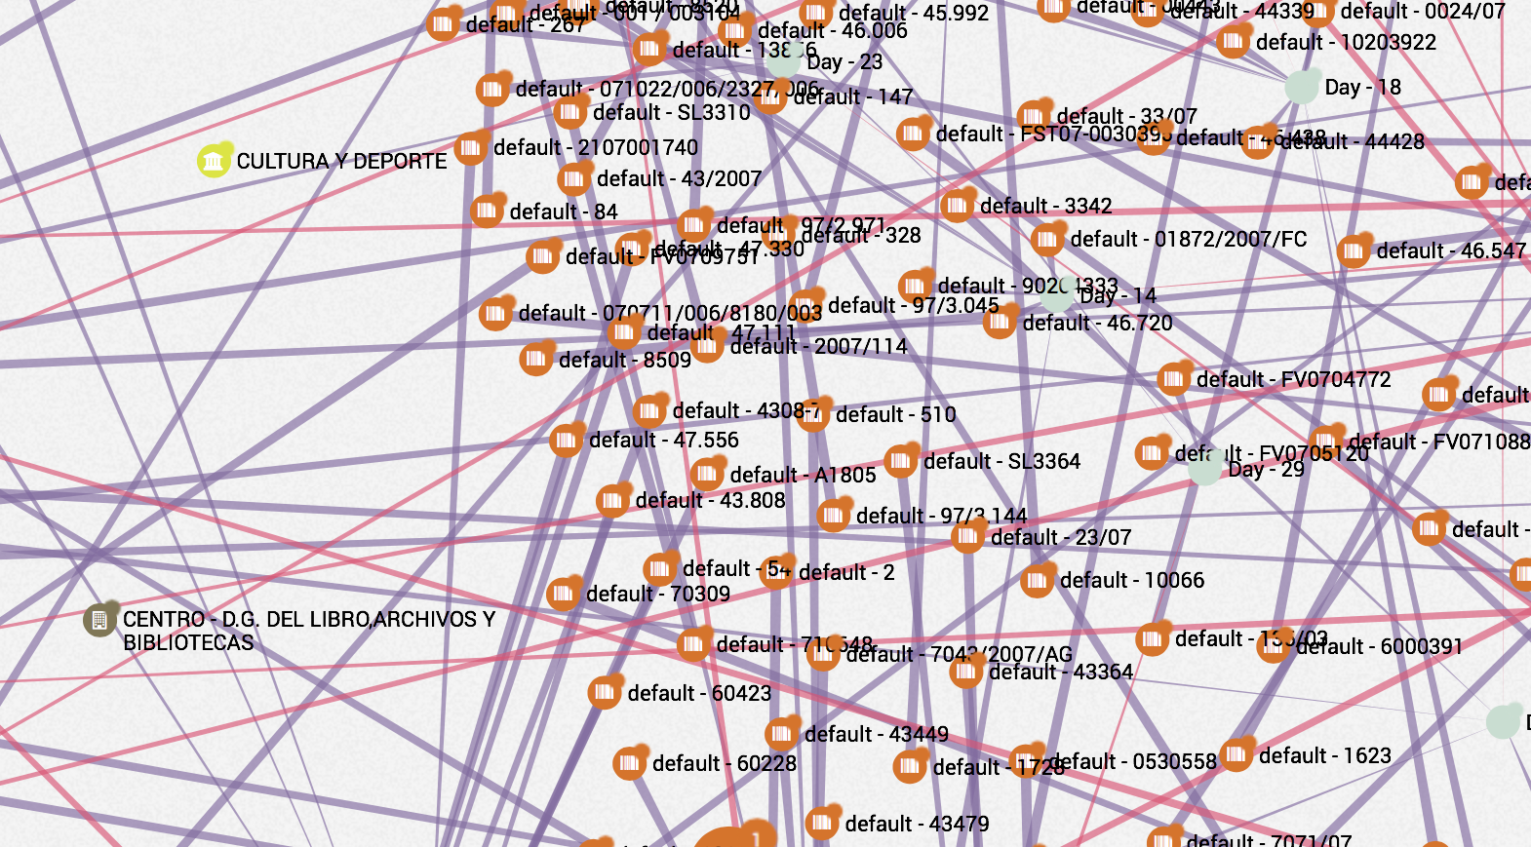
Data Science
Dimensionality explosion: Feature selection

Slide 11
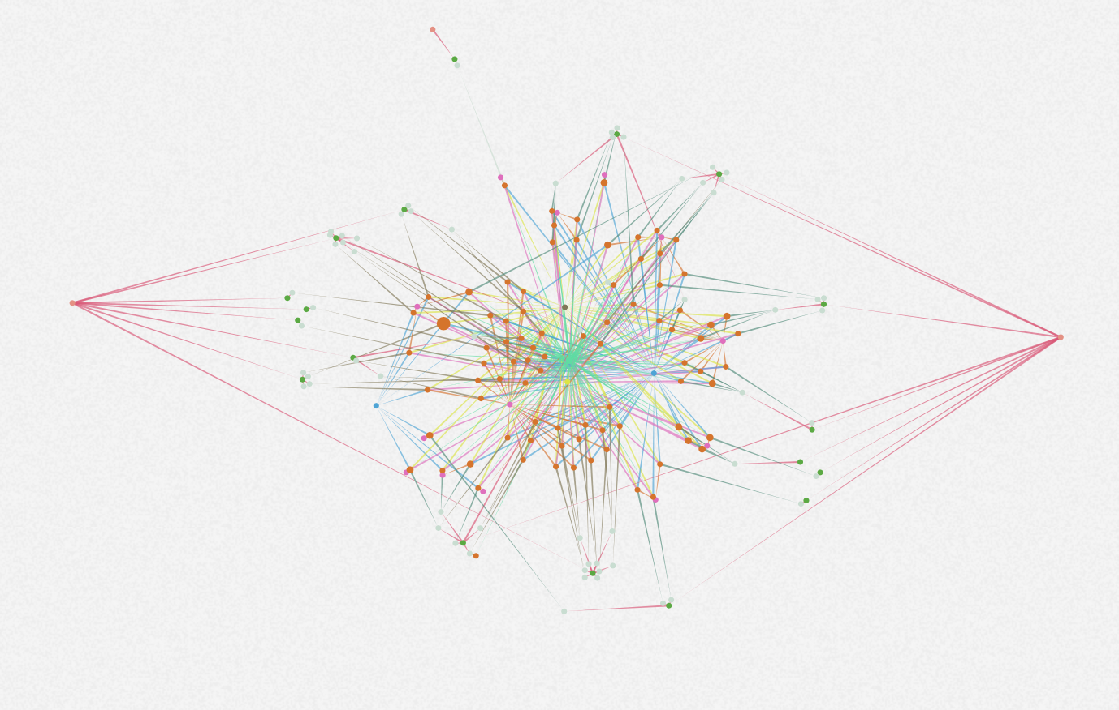
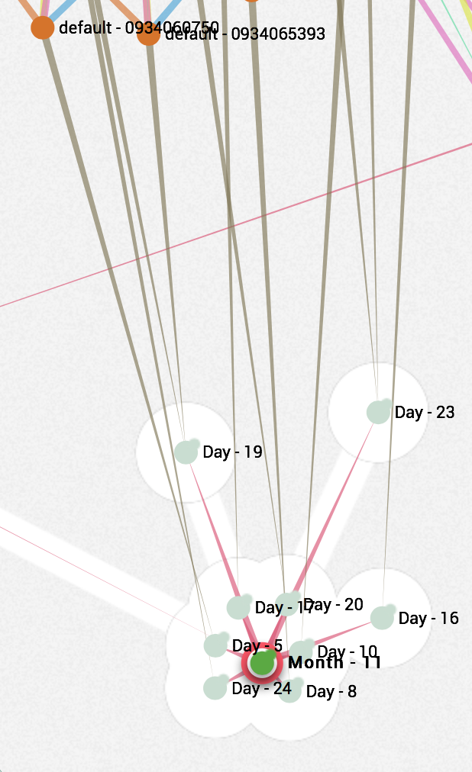
Data Science
Dimensionality explosion: Feature selection

Slide 12
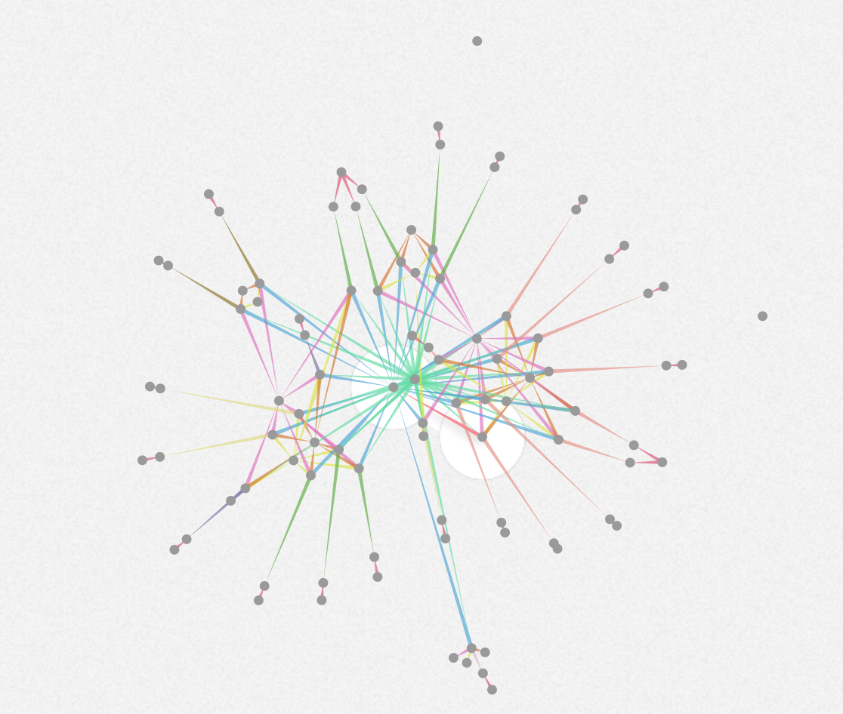
Data Science
Dimensionality explosion: Feature selection

Slide 13
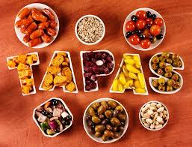
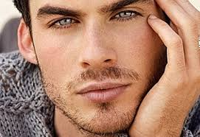
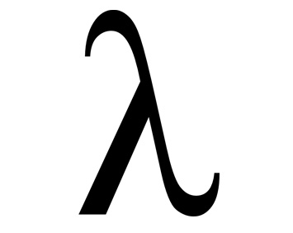
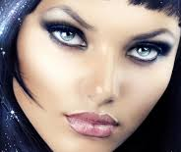
Data Science
Factor de cambio

Slide 14
Data Science
Model switching
Pero…tiene sentido ?

Slide 15
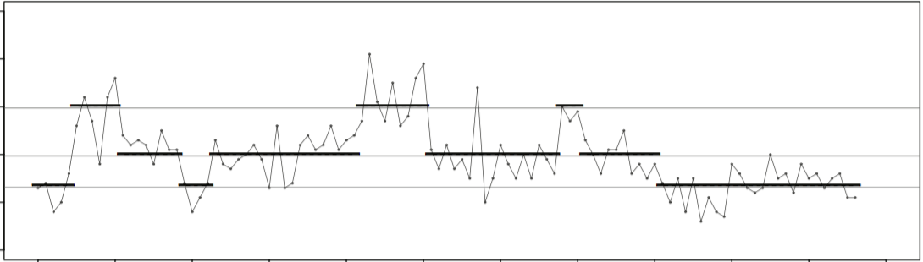
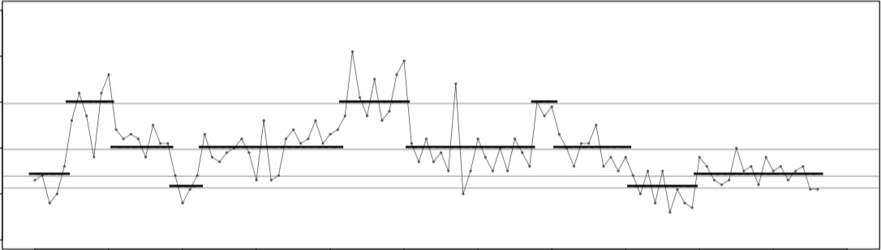
Data Science
Cuanto malos ?
3 ? =>
4 ? =>

Slide 16
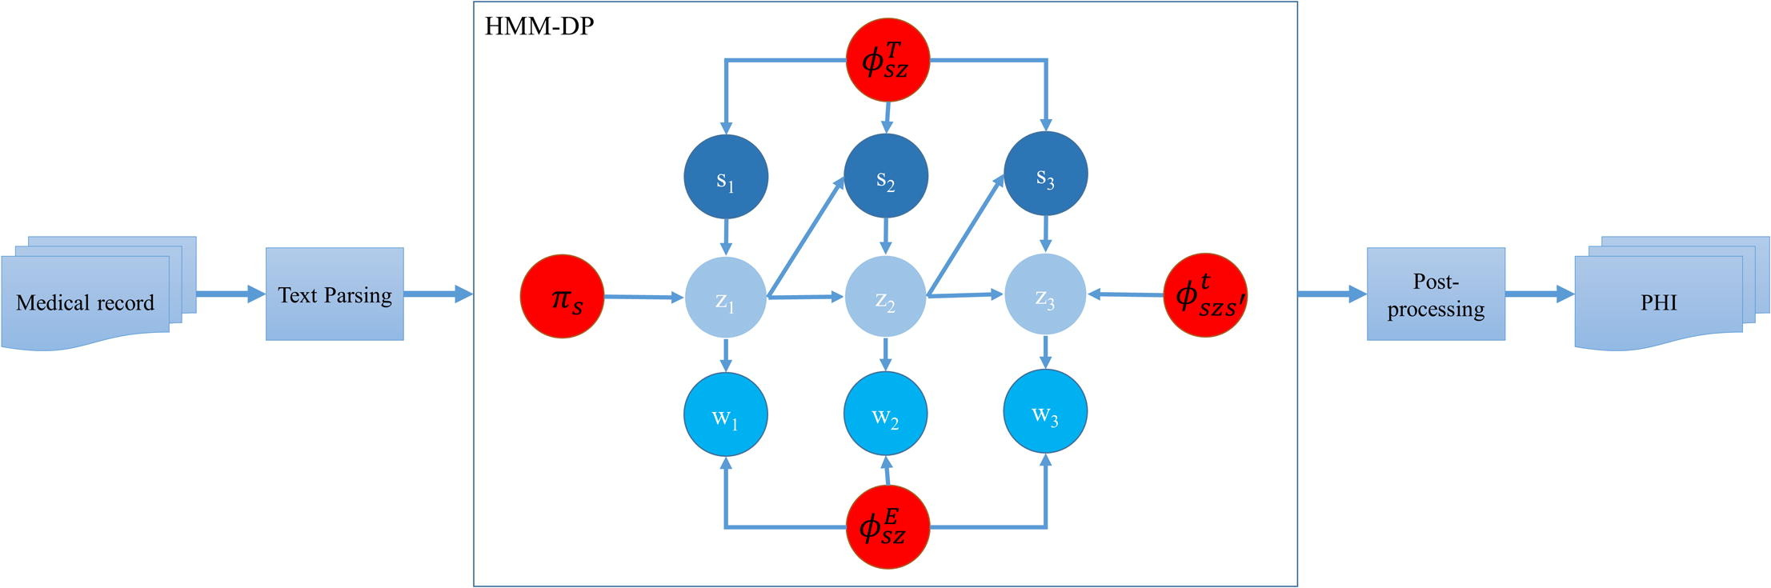
Data Science
Latent dirichlet distribution ~> Viterbi
2014 i2b2/UTHealth
de-identification challenge

Slide 17
Thank you
Q & A

